Slide 1
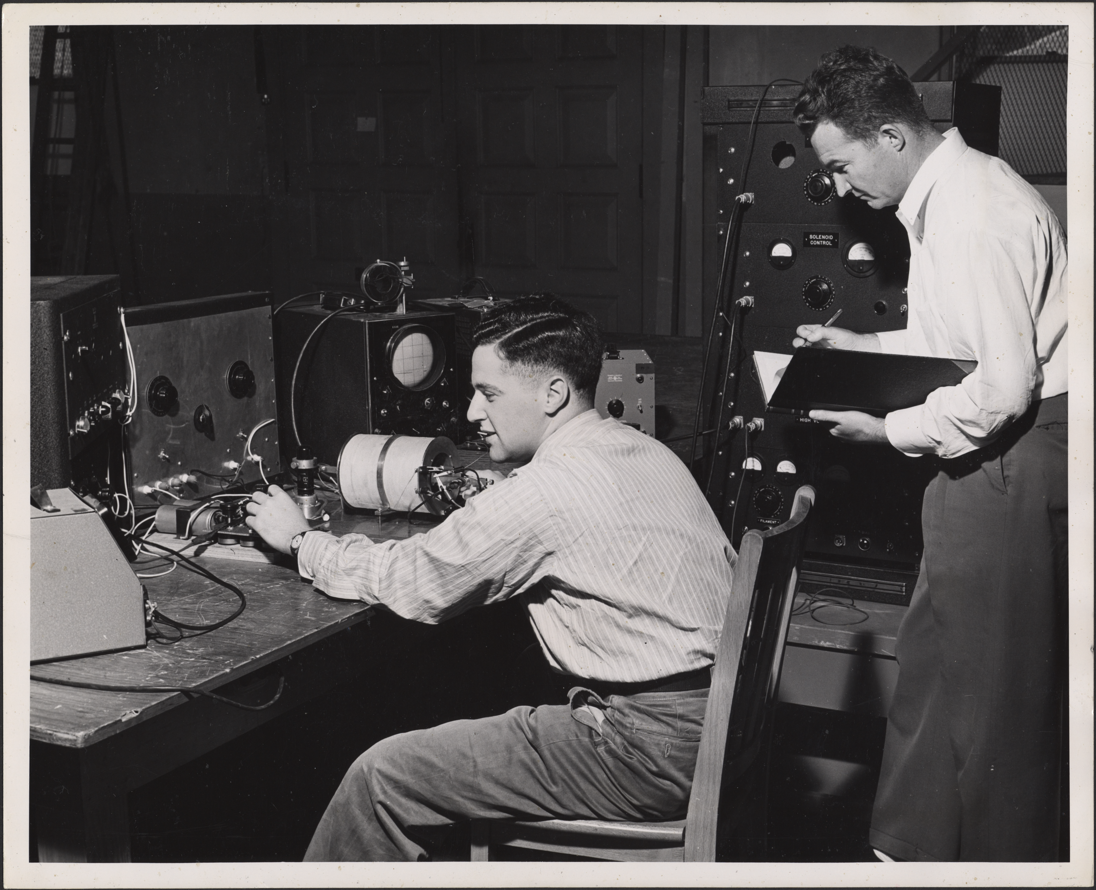
Research Data & the Stanford Digital Repository
Amy Hodge
PhD, Yale, Molecular Biophysics & Biochemistry
Science Data Librarian
amyhodge@stanford.edu
Image courtesy of Stanford University Archives
Notes:
Hi. My name is Amy Hodge, and I’m the science data librarian for Stanford Libraries and I am basically in charge of our Research Data Management Services. Just so you know where I’m coming from, my background is in science. I have a PhD from Yale in molecular biophysics and biochemistry, and I spent about 10 years working mostly at companies on science databases of various types.

Slide 2

Notes:
Back in February, the President’s Office of Science and Technology Policy issued a memo. Some of you may have heard about this memo. It directs federal funding agencies to develop plans to support increased public access to the scientific publications and digital scientific data that are products of that funded research, and to promote deposit of data in publicly-accessible databases. Data is defined as the digital recorded factual material commonly accepted in the scientific community as necessary to validate research findings including data sets used to support scholarly publications. Those plans were due to the OSTP on August 22. I’m going to talk with you today about Stanford Library’s Data Management Services and in particular about the Stanford Digital Repository and how our services can help you in a variety of ways, including meeting these new requirements. I'll begin by telling you a few quick stories -- true stories -- about some Stanford scientists and their data.
The Office of Science and Technology Policy (OSTP) hereby directs each Federal agency with over $100 million in annual conduct of research and development expenditures to develop a plan to support increased public access to the results of research funded by the Federal Government.
Further, each agency plan for both scientific publications and digital scientific data must contain the following elements: a strategy for improving the public’s ability to locate and access digital data resulting from federally funded scientific research...
...digitally formatted scientific data resulting from unclassified research supported wholly or in part by Federal funding should be stored and publicly accessible to search, retrieve, and analyze. For purposes of this memorandum, data is defined, consistent with OMB circular A-110, as the digital recorded factual material commonly accepted in the scientific community as necessary to validate research findings including data sets used to support scholarly publications,
Each agency’s public access plan shall [among other things]:
1. Ensure that all extramural researchers receiving Federal grants and contracts for scientific research and intramural researchers develop data management plans, as appropriate, describing how they will provide for long-term preservation of, and access to, scientific data in digital formats resulting from federally funded research, or explaining why long-term preservation and access cannot be justified;
2. Promote the deposit of data in publicly accessible databases, where appropriate and available;

Slide 3
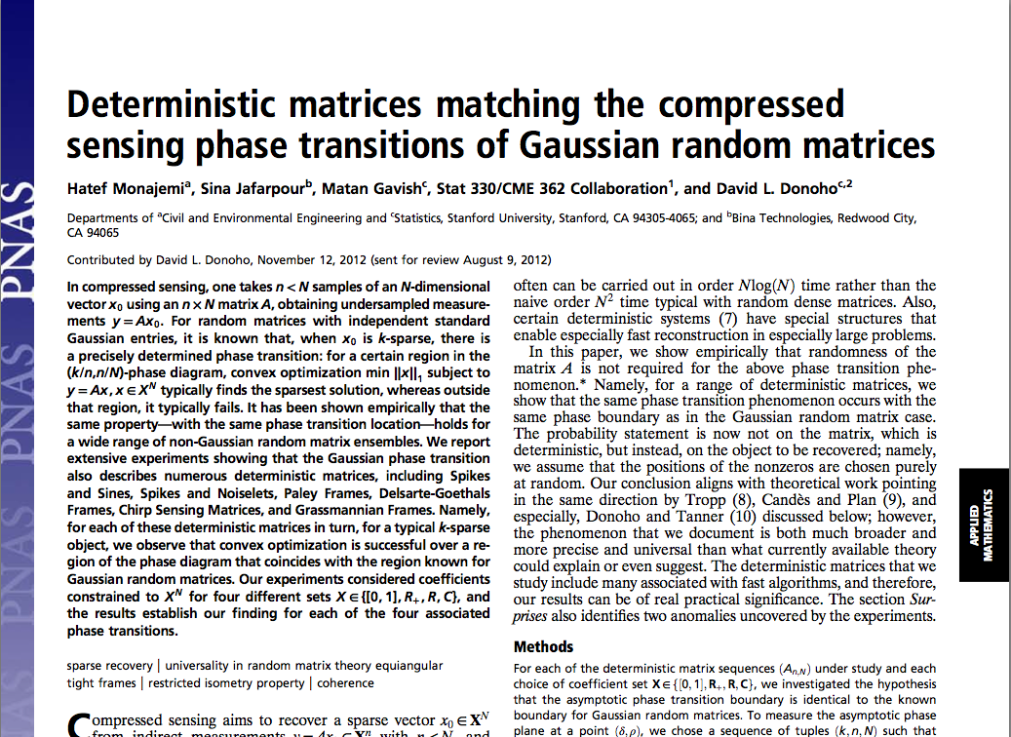
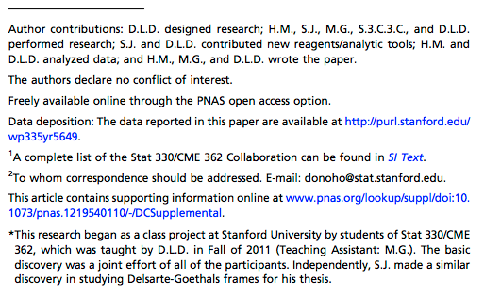
Notes:
The first story is about David Donoho, a professor of Statistics, and his graduate students Hatef and Matan. They were publishing a paper in PNAS, and the journal was requiring that they also make available online supplementary data that supported the results in the paper. David and Hatef and Matan were happy to provide these data files and even the code that had been written for this project, however, the journal did not provide any way to do this. And so Hatef went looking for a solution for publishing their supplementary data and discovered that....the SDR can do that.

Slide 4
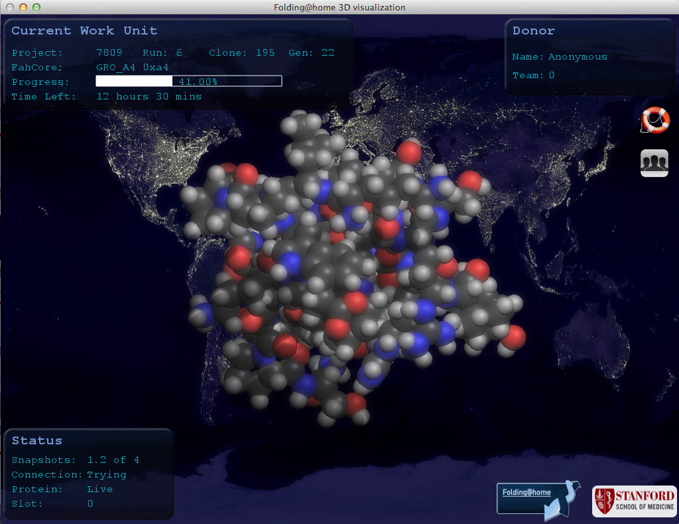
Notes:
Folding@home is a long-running project, well-known at Stanford and beyond. They have built software that allows anyone, anywhere in the world, to do protein folding calculations on the spare cycles on their computers. All that data is then compiled and analyzed here at Stanford. Over the years that this project has been running, you can imagine, they have compiled a huge amount of data that they are interested in making easily discoverable by researchers anywhere. The SDR can do that.

Slide 5
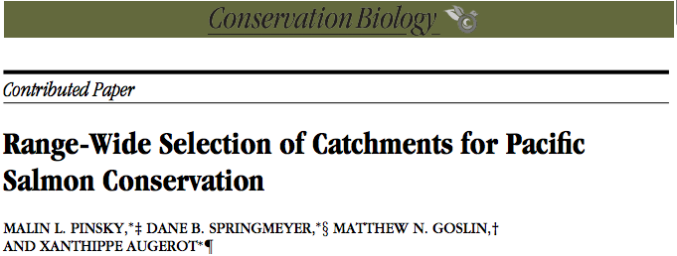
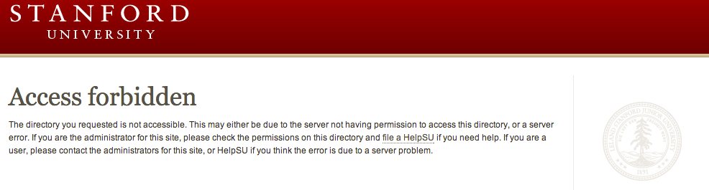
Notes:
This is a story of forbidden access....and Malin Pinsky, a former Stanford researcher who is now at Princeton. Once upon a time (in 2009) he published an article in Conservation Biology. In that article he made reference to some additional data sets that he made available online. The problem came when he left Stanford a couple of years later, and the data suddenly became inaccessible because where he had published it was in his AFS space. And everyone who tried to reach that data saw only this. He began a search for a way to make the data accessible again. And he discovered that the SDR can do that.

Slide 6
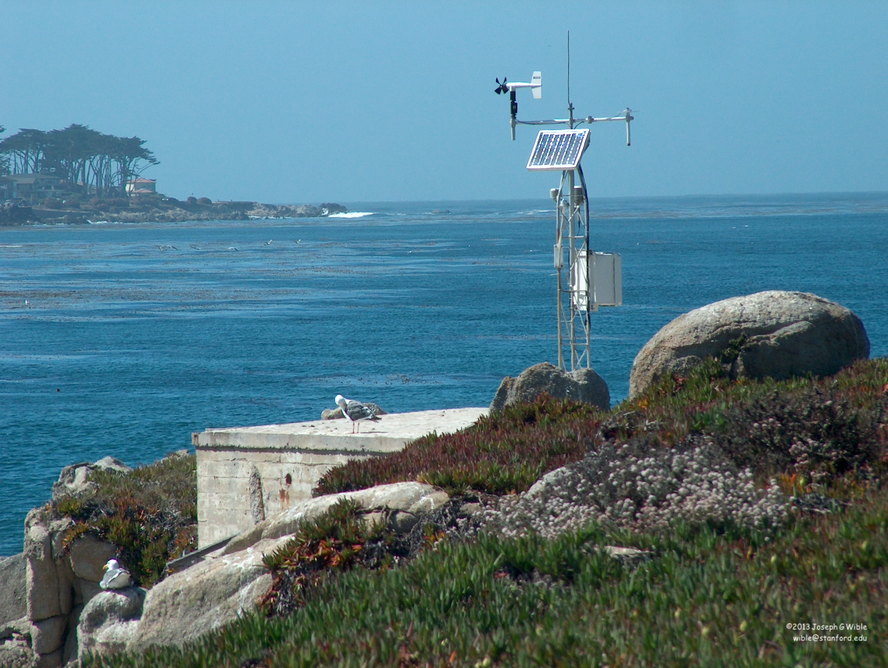
Notes:
Researchers at Hopkins Marine Station are involved in many long-term monitoring projects. Some of these projects have been going on for close to 100 years. This is a weather station where they measure things like wind, precipitation, and temperature every 10 minutes, every day of the year.

Slide 7
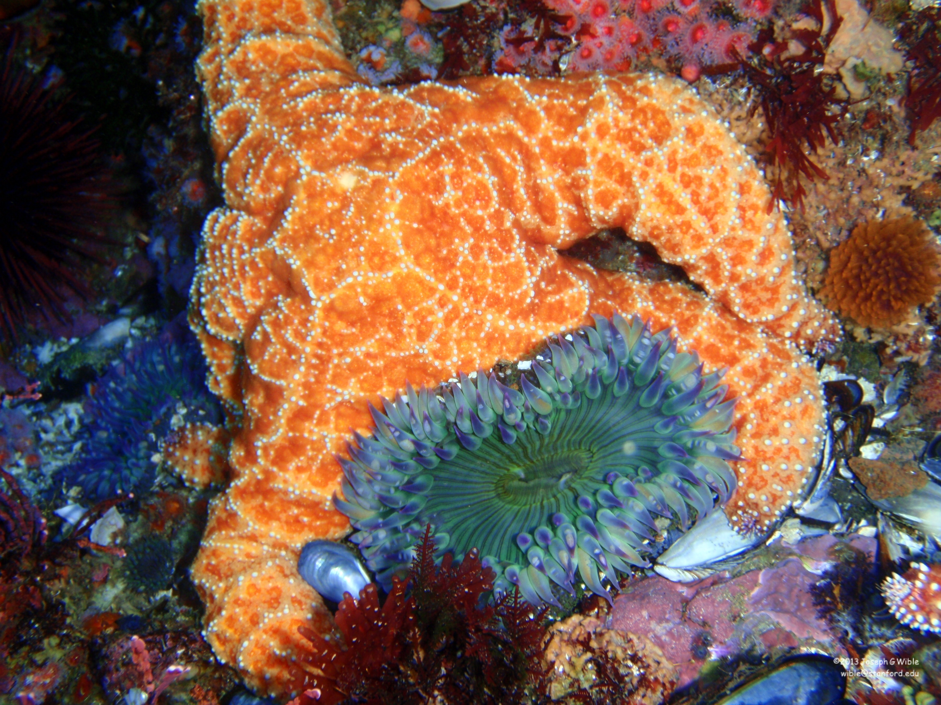
Notes:
They also monitor a variety of marine populations, like kelp, barnacles, and the sea stars shown here, as well as marine mammal populations like harbor seals, sea otters, and sea lions. Because these data provide insight into broad topics like climate change, and - because of their historical nature - they can't be replicated, it's important that they be preserved for use by other researchers in the future. And you probably know by now that....the SDR can do this too.

Slide 8
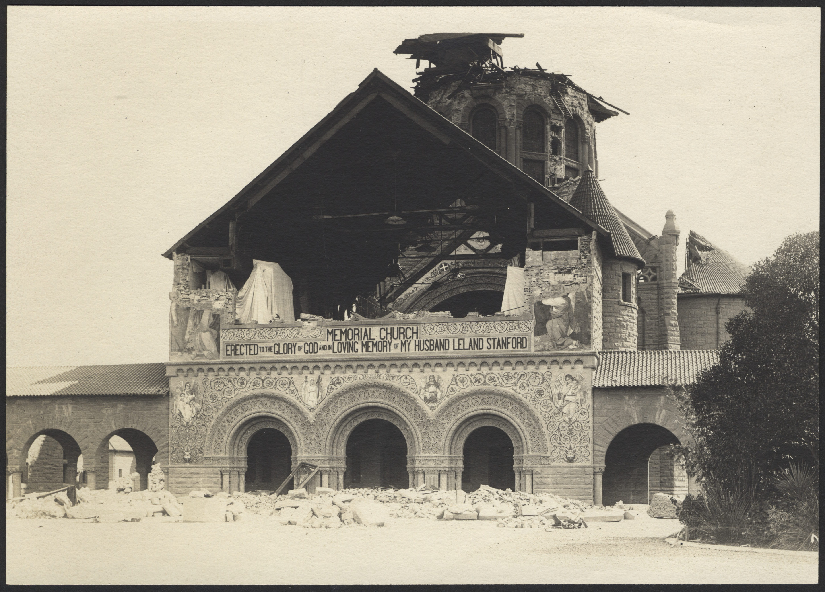
Image by Berton Crandall, 1906, courtesy of Stanford University Archives
Notes:
The SDR can also be used to preserve and share things like technical reports (preservation of the Blume Center Technical Reports is in currently in progress)...

Slide 9
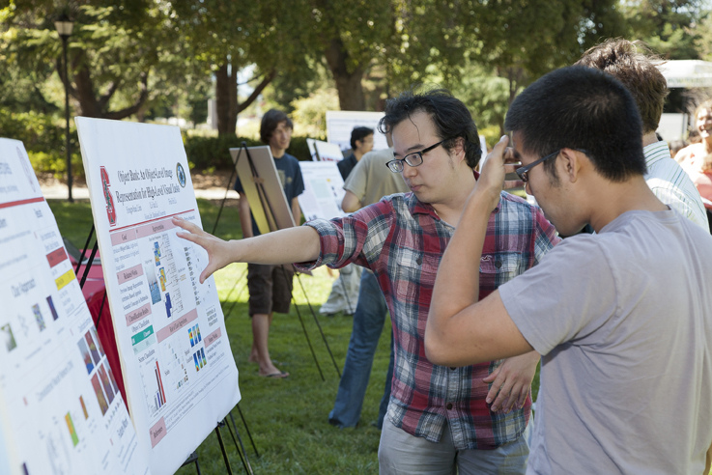
Image by Stanford Engineering, 2011
Notes:
...your department or school’s undergraduate honors theses...

Slide 10
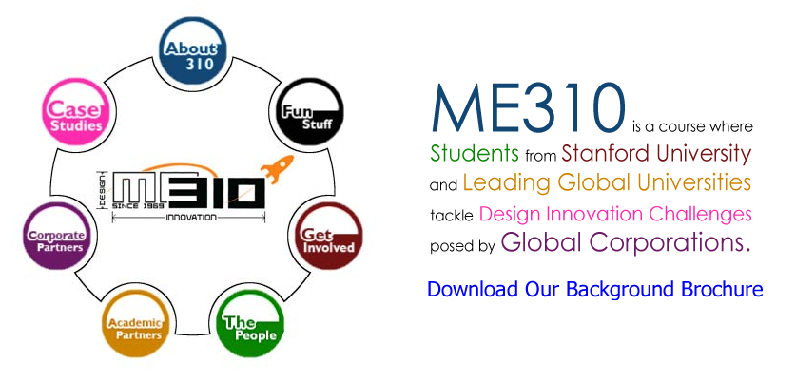
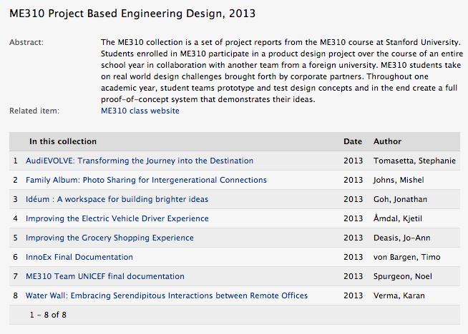
Notes:
...and final student projects from important courses.
The question then is, how does the SDR do all of these things?

Slide 11
http://purl.stanford.edu/wp335yr5649
Notes:
This is the answer. The persistent URL, or PURL. When you deposit data into the SDR you get a persistent URL at which that data can always be accessed. Always.

Slide 12
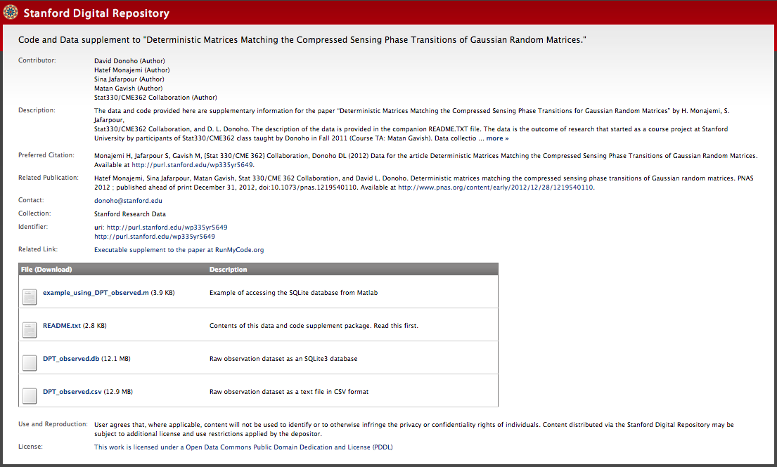
Notes:
Here's what a PURL page for a data deposit looks like. What you see here basically reflects the information that you are required to provide when you deposit data via our self-deposit web interface: authors, a description, how you would like these data to be cited, any associated publications, who to contact about the data, and any other related links. Then there is a list files that can be downloaded with descriptions. You also have options to choose an embargo period, assign a license, and decide whether you want the PURL page to be visible to anyone in the world or just Stanford.
We consider this a lightweight approach to meeting NSF requirements for data sharing and preservation.
And I'm hoping your next question is, How do I get a PURL for my data? It's very easy to do, takes just a few minutes, and three simple steps.

Slide 13
amyhodge@stanford.edu
Notes:
Step one. Email me. Access to the web-based self-deposit interface is via your SUNet ID – and to anyone with a SUNet ID (faculty, research staff, post-docs, students), however, it is currently gated, so I need to specifically give access to whomever is making or reviewing deposits. I’m also available to provide whatever kind of support you might need when you’re depositing data.

Slide 14
sdr.stanford.edu
Notes:
Step two. Go to sdr.stanford.edu. Here you can create a new item, get your persistent URL, upload your files, and describe the data. You will also need to agree to the terms of deposit. The SDR is content agnostic – you can deposit files in any format.

Slide 15

Notes:
Step three. Publish. Easy as that.

Slide 16
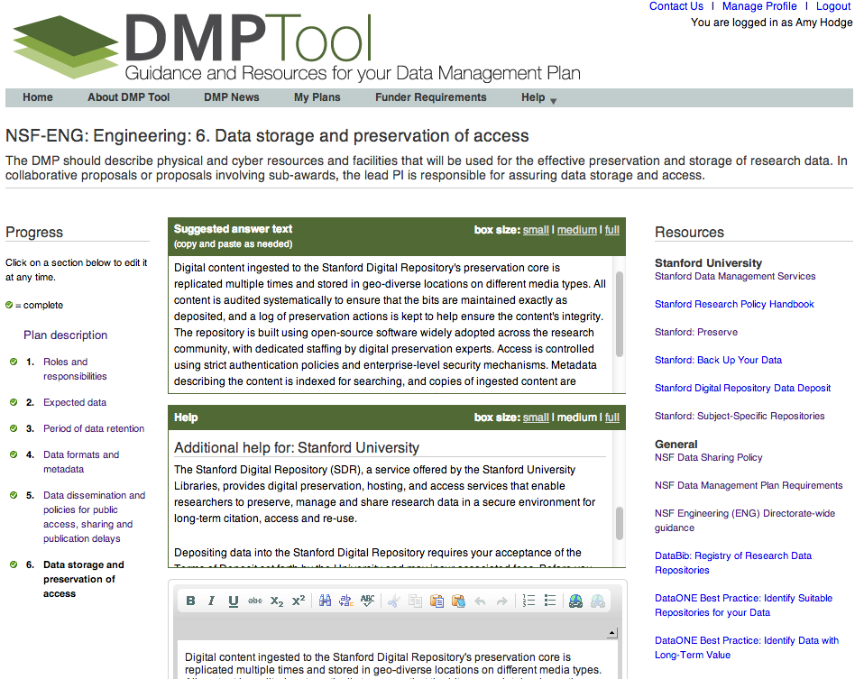
Notes:
Data Management Services always provides other tools and services, including access to the DMPTool, which provides assistance with writing data management plans for research grant proposals.

Slide 17
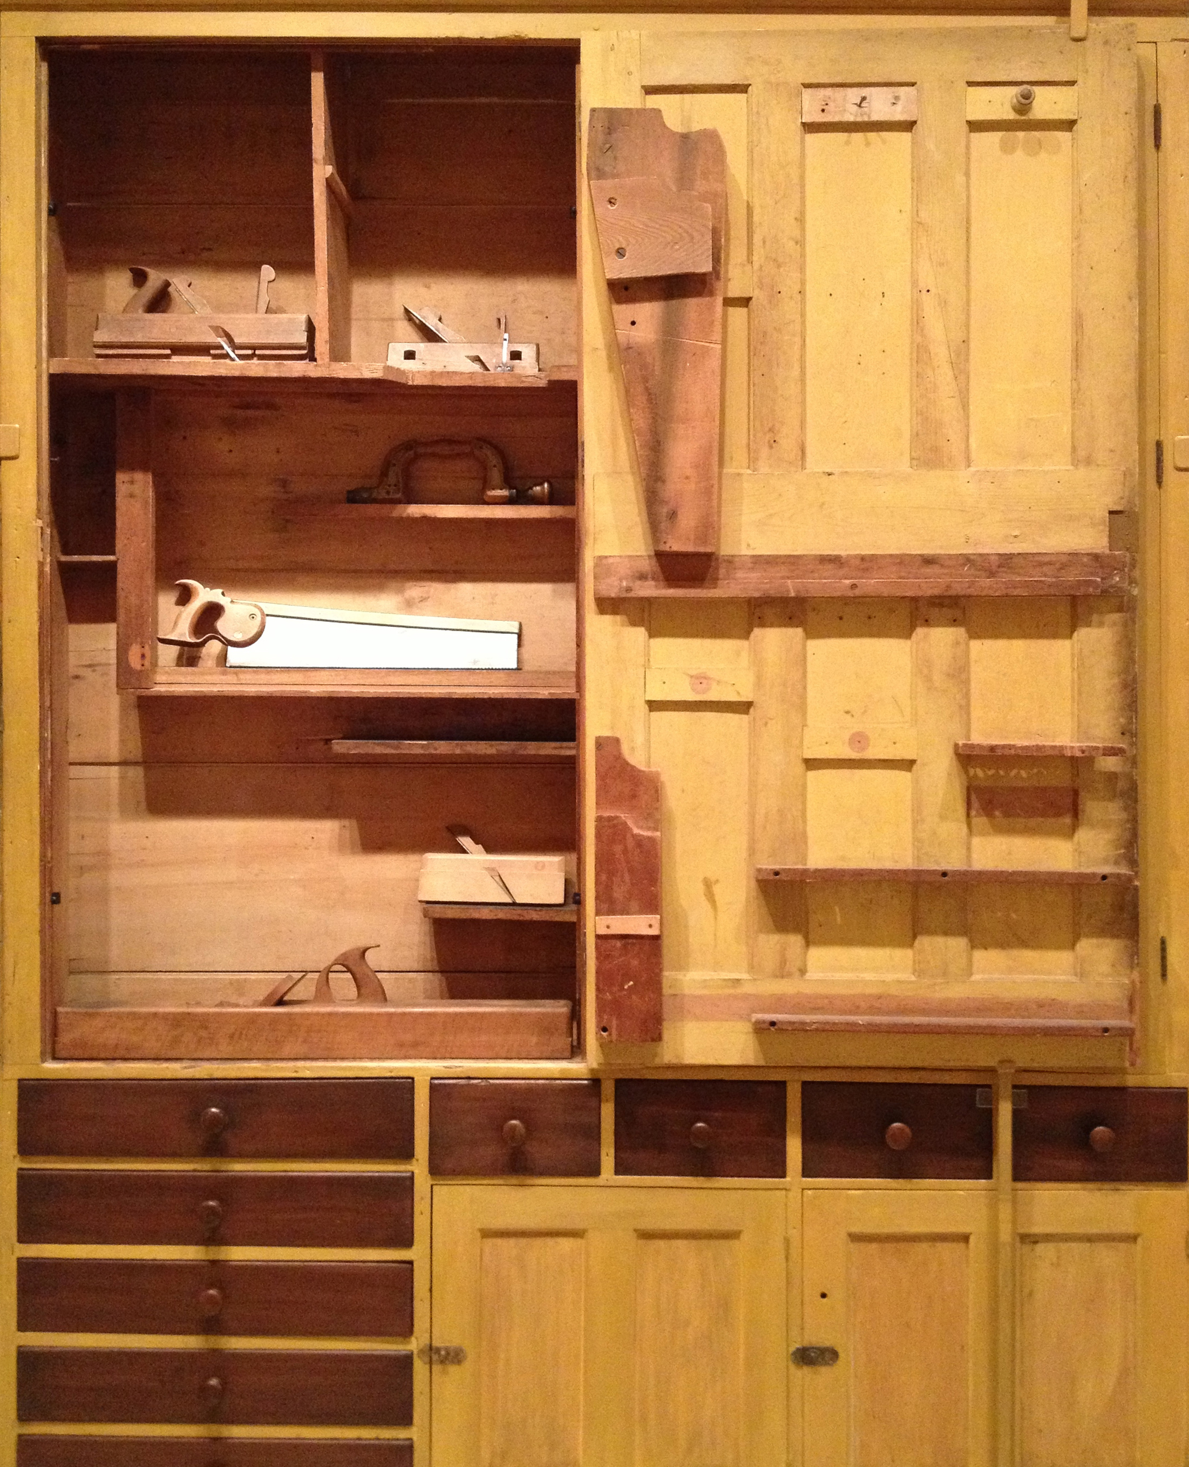
Image by Amy Hodge
Notes:
We also do workshops, including some this fall on best practices for your research data,...

Slide 18

Image by US Marine Corps
Notes:
And we are also holding a Software Carpentry boot camp in January targeted at experimental physics students that will help them be more productive by teaching them basic computing skills like program design, version control, testing, task automation, documentation, and debugging.

Slide 19
amyhodge@stanford.edu

Slide 20
Resources
OSTP Memo:
Increasing Access to the Results of Federally Funded Scientific Research
http://www.whitehouse.gov/sites/default/files/microsites/ostp/ostp_public_access_memo_2013.pdf
DMPTool
http://dataplan.stanford.edu
Data Services web site
https://lib.stanford.edu/data-services
PURL examples
Donoho: http://purl.stanford.edu/wp335yr5649
Pande, Folding@home: http://purl.stanford.edu/wt101ks3240
Pinsky: http://purl.stanford.edu/zc193vn8689
Hopkins Marine Station: http://purl.stanford.edu/wc313bt2358

